Slide 1

Data Gateway Configurator
Howe University
Welcome howeg@advisory.com Logout
Congratulations and welcome to your subscription to EAB’s Student Success Collaborative.
Let’s get started by configuring your installation to receive your student information.
What Shall We Do Next?
SSC Populations Left to Configure:
Population | Status | Est. Time
Active Undergraduate Students | Started | 1 hour
Student Registered Courses | Pending | 1 hour
Student External Course Credit | Pending | 30 minutes
Student Academic Term Status | Complete | 0 hours
Any person pursuing
an undergraduate
degree at Howe University
who is recognized
as an active student by the
institution.
SSC Fulfillment Schedule:
Population | Cycle | Status
Active Undergraduate Students | Weekly | Ready
Student Registered Courses | Once Per Term | Ready

Slide 2
Data Gateway Configurator
Howe University
Welcome howeg@advisory.com Logout
Active Undergraduate Students
Population Configuration
Identifier
Population Conditions
Attributes
[STUDENT].[ID]
Default Key:
Howe University Master Student Identifier
Identifier Parts | Seq. | Description
Student Identifier | 1 | Howe University assigned master identifier
You have mapped Attributes
to Sources which you haven’t
linked to [STUDENT].[ID]
Bindings
Incomplete
Alternate Key:
Admissions Student Identifier
Identifier Parts | Seq. | Description
Applicant Identifier | 1 | Applicant identifier
Qualifier Suffix | 2 | Admissions class qualifier
Bindings
Complete
Mappings
Incomplete

Slide 3
Data Gateway Configurator
Howe University
Welcome howeg@advisory.com Logout
Active Undergraduate Students
Population Configuration
Identifier
Population Conditions
Attributes
[STUDENT].[ID] Bindings
Howe University Master Student Identifier
Source | Structure | Student Identifier
Howe Univ Banner | SPRIDEN | SPRIDEN_ID
Howe Univ Banner | GOREMAL | Unbound
Define link between
Howe University Master
Student Identifier and the
GOREMAL structure in your
Howe Univ Banner
Source system.

Slide 4
Data Gateway Configurator
Howe University
Welcome howeg@advisory.com Logout
Active Undergraduate Students
Population Configuration
Identifier
Population Conditions
Attributes
[STUDENT].[ID] Bindings
Howe University Master Student Identifier
Source | Structure | Student Identifier
Howe Univ Banner | SPRIDEN | SPRIDEN_ID
Howe Univ Banner | GOREMAL | GOREMAL_SPRIDEN_ID

Slide 5
Data Gateway Configurator
Howe University
Welcome howeg@advisory.com Logout
Active Undergraduate Students
Population Configuration
Identifier
Population Conditions
Attributes
[STUDENT].[ID]
Default Key:
Howe University Master Student Identifier
You have required Attributes
which you haven’t
mapped to any source.
Identifier Parts | Seq. | Description
Student Identifier | 1 | Howe University assigned master identifier
Bindings
Required Complete, Optional Incomplete
Alternate Key:
Admissions Student Identifier
Identifier Parts | Seq. | Description
Applicant Identifier | 1 | Applicant identifier
Qualifier Suffix | 2 | Admissions class qualifier
You have linked Attributes
to the Admissions
Student Identifier that you
need to map to the Howe
University Master Student
Identifier.
Bindings
Complete
Mappings
Incomplete

Slide 6
Data Gateway Configurator
Howe University
Welcome howeg@advisory.com Logout
Active Undergraduate Students
Population Configuration
Attributes
Identifier
Population Conditions
Attribute Name | Req? | Binding | Source
Student Identifier | Y | [STUDENT].[ID]
First Name | Y | SPRIDEN.SPRIDEN_FIRST_NM | Banner
Middle Name | N | Unbound
Last Name | Y | SPRIDEN.SPRIDEN_LAST_NM | Banner
Date of Birth | N | Unbound
EMAIL Address | Y | Unbound
Gender | N | Unbound
Ethnicity Code | N | Unbound
Deceased Indicator | N | Unbound
You have required Attributes
which you haven’t
mapped to any source.

Slide 7
Data Gateway Configurator
Howe University
Welcome howeg@advisory.com Logout
Active Undergraduate Students
Population Configuration
Attributes
Identifier
Population Conditions
Attribute Name | Req? | Binding | Source
Student Identifier | Y | [STUDENT].[ID]
First Name | Y | SPRIDEN.SPRIDEN_FIRST_NM | Banner
Middle Name | N | Unbound
Last Name | Y | SPRIDEN.SPRIDEN_LAST_NM | Banner
Date of Birth | N | Unbound
EMAIL Address | Y | GOREMAL. GOREMAL_EMAIL_ADDRESS | Banner
Gender | N | Unbound
Ethnicity Code | N | Unbound
Deceased Indicator | N | Unbound

Slide 8
Adding New Features to Application
New populations, attributes added by PT
User notified of opportunity to use new features via email
Configuration same in kind as initial configuration

Slide 9
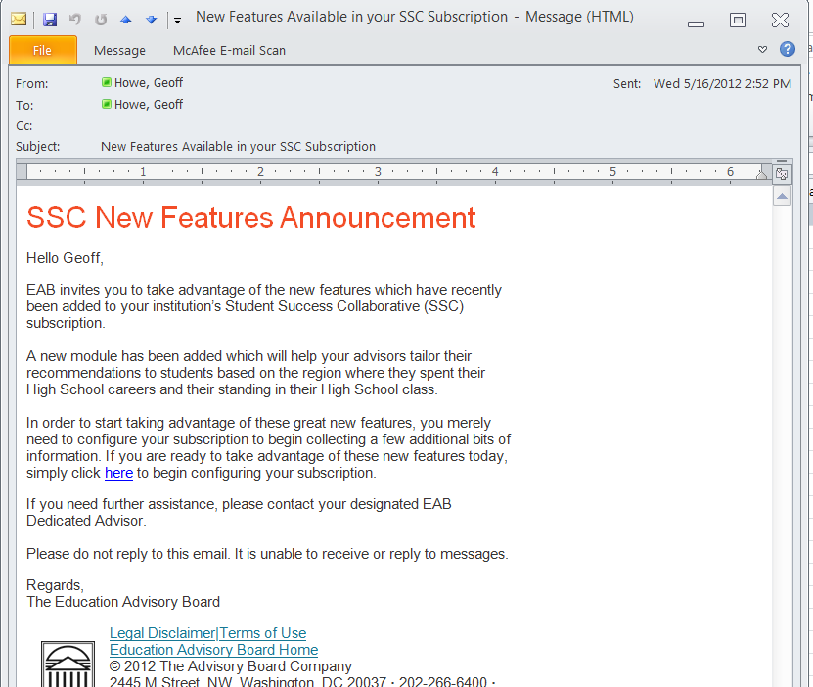

Slide 10
Data Gateway Configurator
Howe University
Welcome howeg@advisory.com Logout
Congratulations and welcome to your subscription to EAB’s Student Success Collaborative.
Let’s get started by configuring your installation to receive your student information.
What Shall We Do Next?
SSC Populations Left to Configure:
Population | Status | Est. Time
Active Undergraduate Students | New Features | 1 hour
Student Registered Courses | Complete | 1 hour
Student External Course Credit | Complete | 30 minutes
Student Academic Term Status | Complete | 0 hours
SSC Fulfillment Schedule:
Population | Cycle | Status
Active Undergraduate Students | Weekly | Ready
Student Registered Courses | Once Per Term | Ready

Slide 11
Data Gateway Configurator
Howe University
Welcome howeg@advisory.com Logout
Active Undergraduate Students
Population Configuration
Identifier
Population Conditions
Attributes
[STUDENT].[ID] Bindings
Howe University Master Student Identifier
Source | Structure | Student Identifier
Howe Univ Banner | SPRIDEN | SPRIDEN_ID
Howe Univ Banner | GOREMAL | GOREMAL_SPRIDEN_ID
HU Admissions | ZOAHSCD | Unbound

Slide 12
Data Gateway Configurator
Howe University
Welcome howeg@advisory.com Logout
Active Undergraduate Students
Population Configuration
Identifier
Population Conditions
Attributes
[STUDENT].[ID] Bindings
Howe University Master Student Identifier
Source | Structure | Student Identifier
Howe Univ Banner | SPRIDEN | SPRIDEN_ID
Howe Univ Banner | GOREMAL | GOREMAL_SPRIDEN_ID
HU Admissions | ZOAHSCD | MAP(ZOAHSCD_STDNT_NBR,”ADM”)

Slide 13
Data Gateway Configurator
Howe University
Welcome howeg@advisory.com Logout
Active Undergraduate Students
Population Configuration
Attributes
Identifier
Population Conditions
Attribute Name | Req? | Binding | Source
Student Identifier | Y | [STUDENT].[ID]
First Name | Y | SPRIDEN.SPRIDEN_FIRST_NM | Banner
Middle Name | N | Unbound
Last Name | Y | SPRIDEN.SPRIDEN_LAST_NM | Banner
Date of Birth | N | Unbound
EMAIL Address | Y | GOREMAL. GOREMAL_EMAIL_ADDRESS | Banner
Gender | N | Unbound
Ethnicity Code | N | Unbound
Deceased Indicator | N | Unbound
High School City* | N | ZOAHSCD.HS_NAME | Registrar
High School Class Rank* | N | Unbound

Slide 14
Data Gateway Configurator
Howe University
Welcome howeg@advisory.com Logout
Active Undergraduate Students
Population Configuration
Attributes
Identifier
Population Conditions
Attribute Name | Req? | Binding | Source
Student Identifier | Y | [STUDENT].[ID]
First Name | Y | SPRIDEN.SPRIDEN_FIRST_NM | Banner
Middle Name | N | Unbound
Last Name | Y | SPRIDEN.SPRIDEN_LAST_NM | Banner
Date of Birth | N | Unbound
EMAIL Address | Y | GOREMAL. GOREMAL_EMAIL_ADDRESS | Banner
Gender | N | Unbound
Ethnicity Code | N | Unbound
Deceased Indicator | N | Unbound
High School City* | N | ZOAHSCD.HS_NAME | Registrar
High School Class Rank* | N | ZOAHSCD.CL_RNK | Registrar

